Slide 1
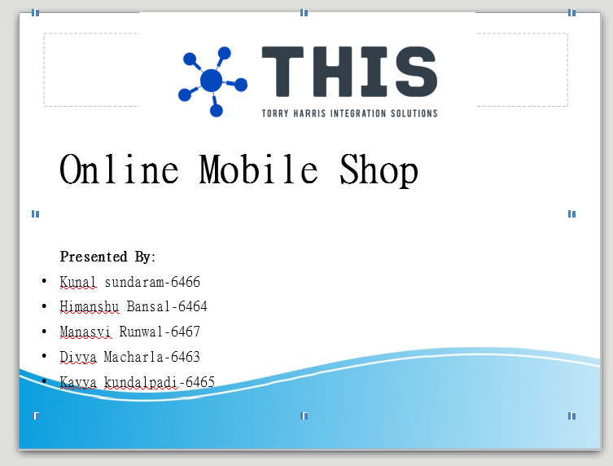
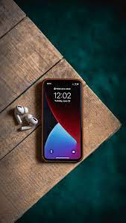
CONTENTS

Slide 2
CONTENTS
Introduction
Problem Statement
System Design
Technologies Used
Results
Future Enhancements

Slide 3
Introduction
There are several different forms of inventory and any business may rely on one Or more forms. One form of inventory that a business may have is products that are ready for sale .For instance, some businesses buy their products from manufacturer and store them in warehouses: such facilities will require warehouse management of inventory.
Such products are ready for sale immediately and require no assembly like, house hold items, furniture, and office suppliers are just a few of many items that can be part of ready for sale inventory.

Slide 4
Problem Statement
In today’s world, everything is digitalized and paper is being used less and less everyday. Current scenario most of mobile shop maintain register dairy where they will write details of customer and mobile. It Takes more time to find particular record.
The primary aim Of the ONLINE MOBILE SHOP(E-commerce website) project is to make easy to buy Mobiles. To access our application first user has to register with details like name, Address, place, mobile, email, place and recent photo.
After user registration complete Admin will approve it based on the details given by user .If user provide valid information Admin will approve the request if user provide invalid information then admin will reject the same.

Slide 5
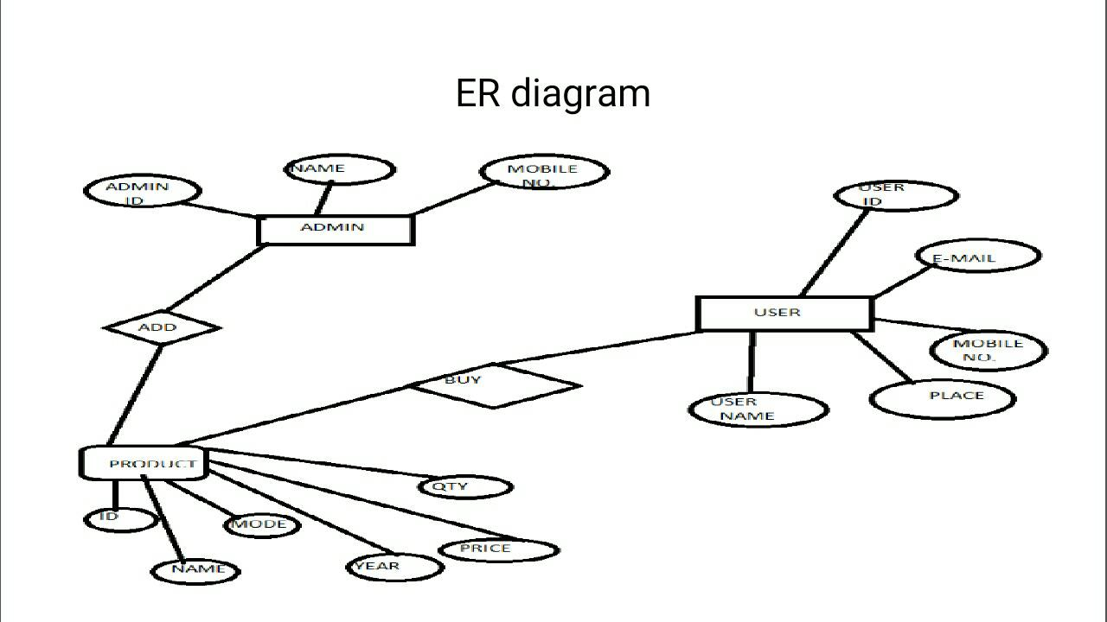
System Design

Slide 6




Technologies Used
Front End:
HTML
CSS
JavaScript
Bootstrap
Back End:
JAVA
Hibernate
MySQL WorkBench

Slide 7
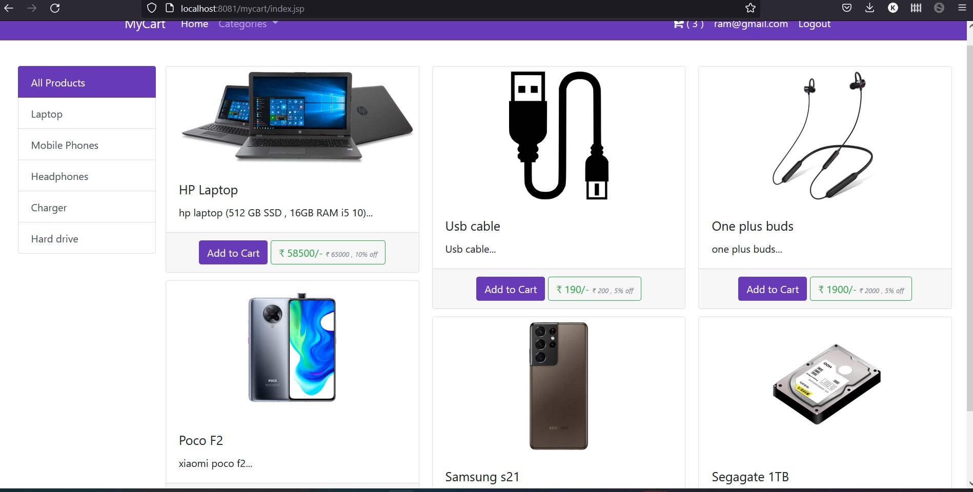
Results
Home Page

Slide 8
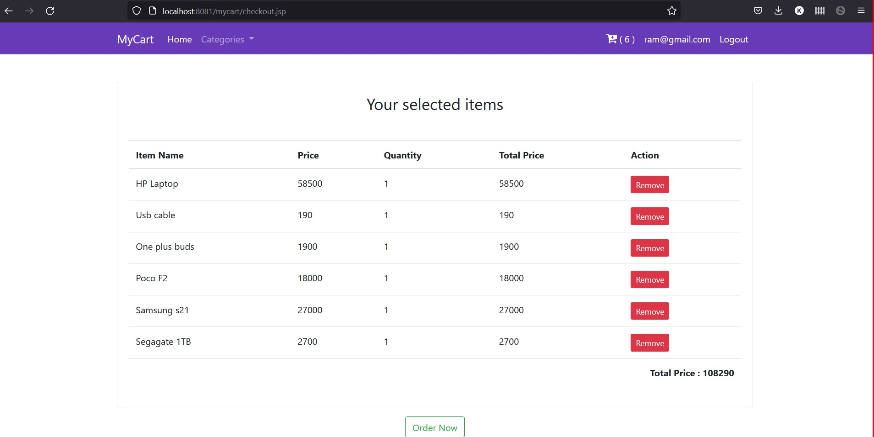
View Cart Page

Slide 9
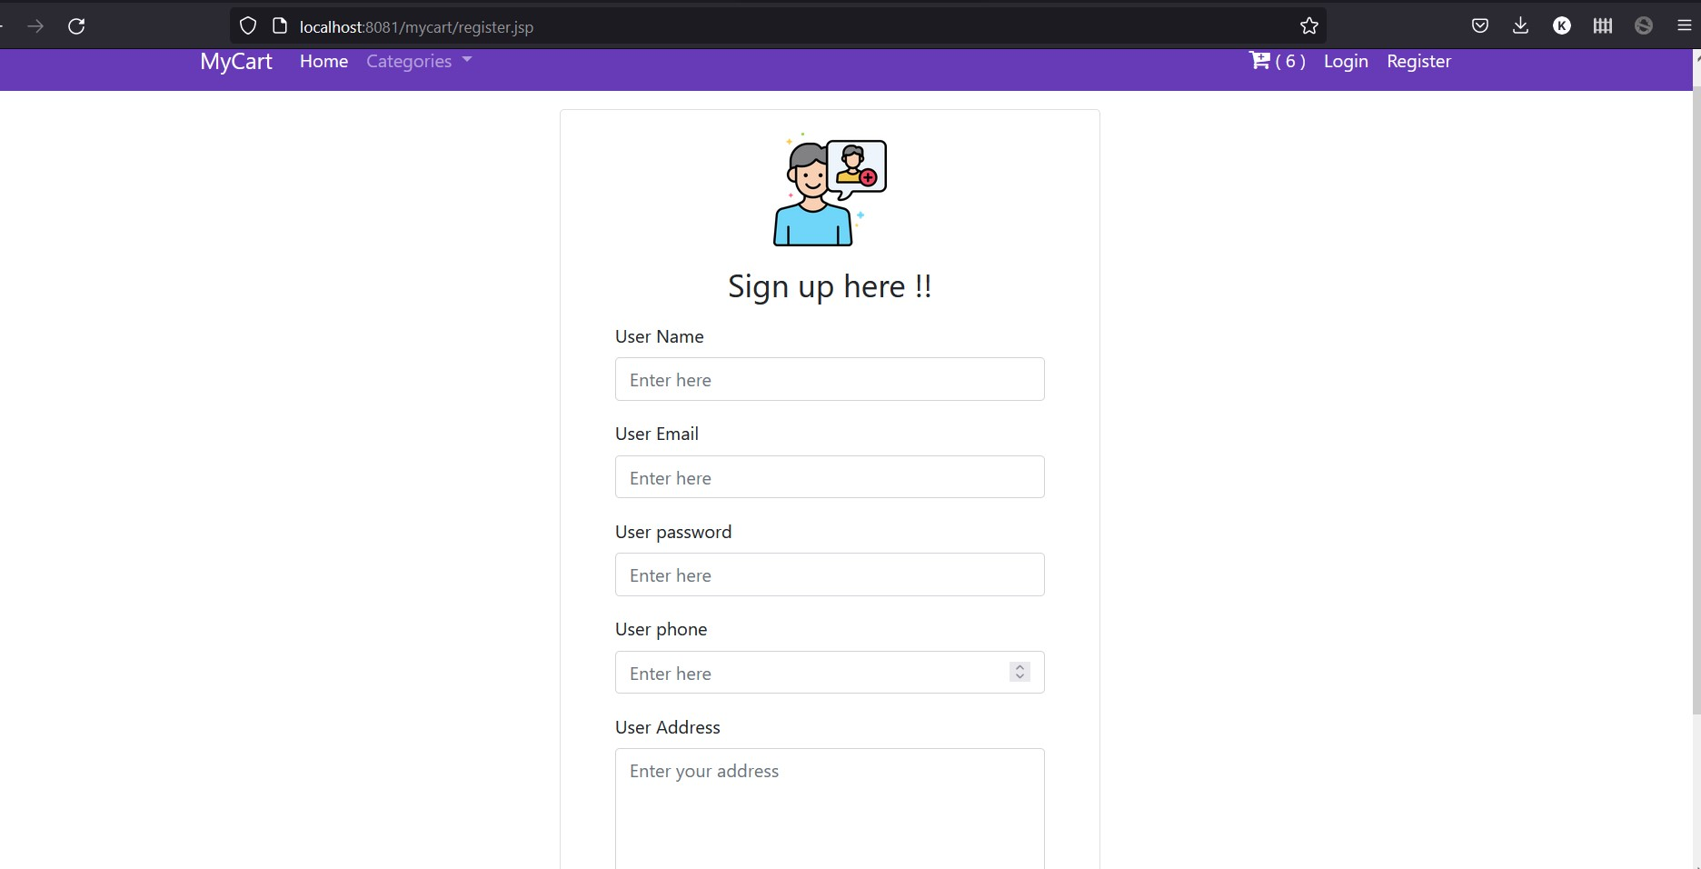
User Registration Page

Slide 10
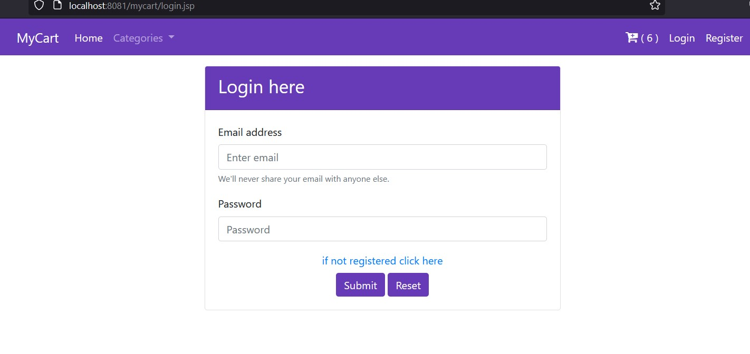
Login Page

Slide 11
Future Enhancement
The application provides appropriate information to users according to chosen service. The project is user friendly. The registered user will view and buy mobile.
Notification will be send to user regarding product details like model number, quantity and price. Almost all leading shops, excepting a few, currently lack an electronic system.
Though some have taken the a id of third-party websites like Facebook® to interact, it comes at the cost of mixing one’s social life with professional. Keeping this in mind, educational institutes will find this software extremely useful.

Slide 12
THANK YOU

